Slide 1
Analyzing Winning Numbers in the New York Powerball Lottery
By Darian Kacanski

Slide 2

Introduction/Purpose
Explore patterns within the New York Powerball Lottery
Dataset (2010-2025).
Benefits anyone who plays or wants to play Powerball. (Who wouldn’t want to increase chances of winning?)
Which Powerball numbers show up most often?
Are there duplicate winning number combinations, and how many times do the duplicate combinations come up?
What is the most common multiplier for Powerball?
Has the number of times winning numbers show up changed over the years?
What are the percentages of numbers showing up from each different number range?

Slide 3
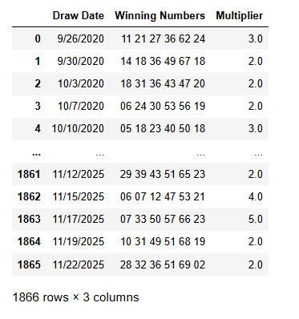
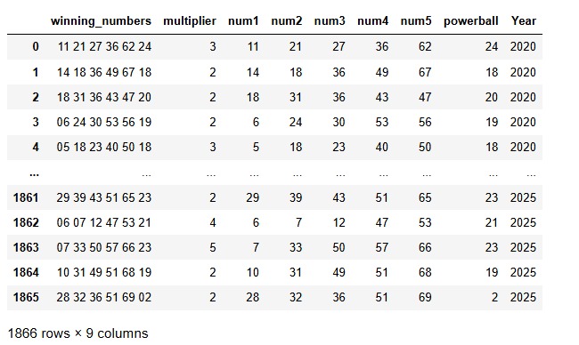
Methodology
I used a dataset from data.gov
I used a Powerball sequence for a row
I used Jupyter Notebook, Pandas, NumPy, and Matplotlib
Before After

Slide 4

Are there duplicate winning number combinations, and if so, how many times do the duplicate combinations come up?
No duplicates

Slide 5
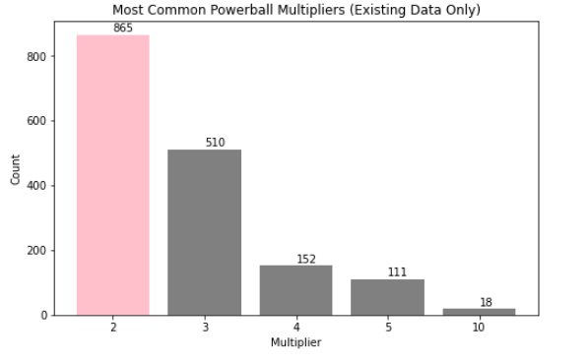
What is the most common multiplier for Powerball?
Most common multiplier was 2x
Thought it would be more interesting / more random

Slide 6
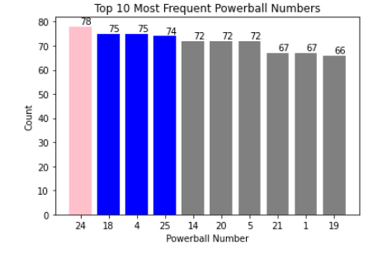
Which powerball numbers show up most often?
Powerball number not the white balls
24 most popular
Condensed it to top 10

Slide 7
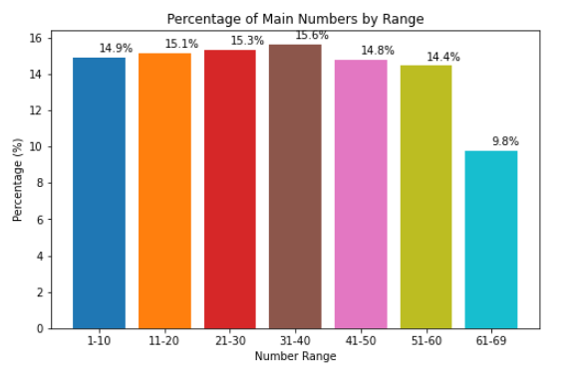
What are the percentages of numbers showing up from each different number range?
Most popular range 31-40
Least popular range 61-69 because of rules of Powerball

Slide 8
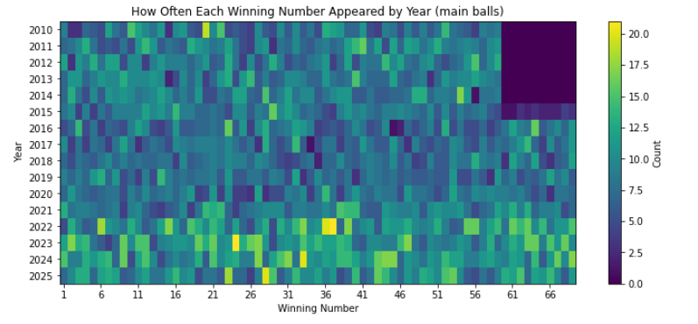
Has the number of times winning numbers show up changed over the years?
Explain heatmap
Why there is a void spot
Good number picks based on this

Slide 9
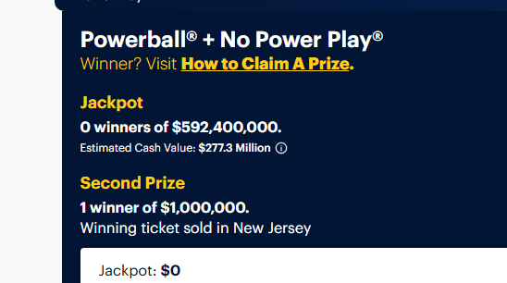
Future work
Scrape from the New York Lottery Powerball website and get jackpots
Analyze why some might be bigger than others
Also instead of analyzing by year I can specify by months or days

Slide 10
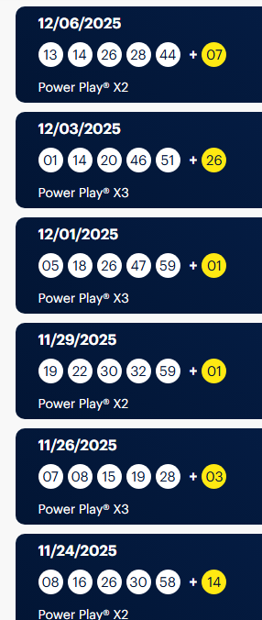
Final Thoughts
My numbers (37, 28,36, 20, 33, 24)
Unpredictable

Slide 11
Appendix
Thank you!
Any Questions

